Slide 1

Key Aspects of Data Ecology in UK Tech Hubs
1898

Slide 2
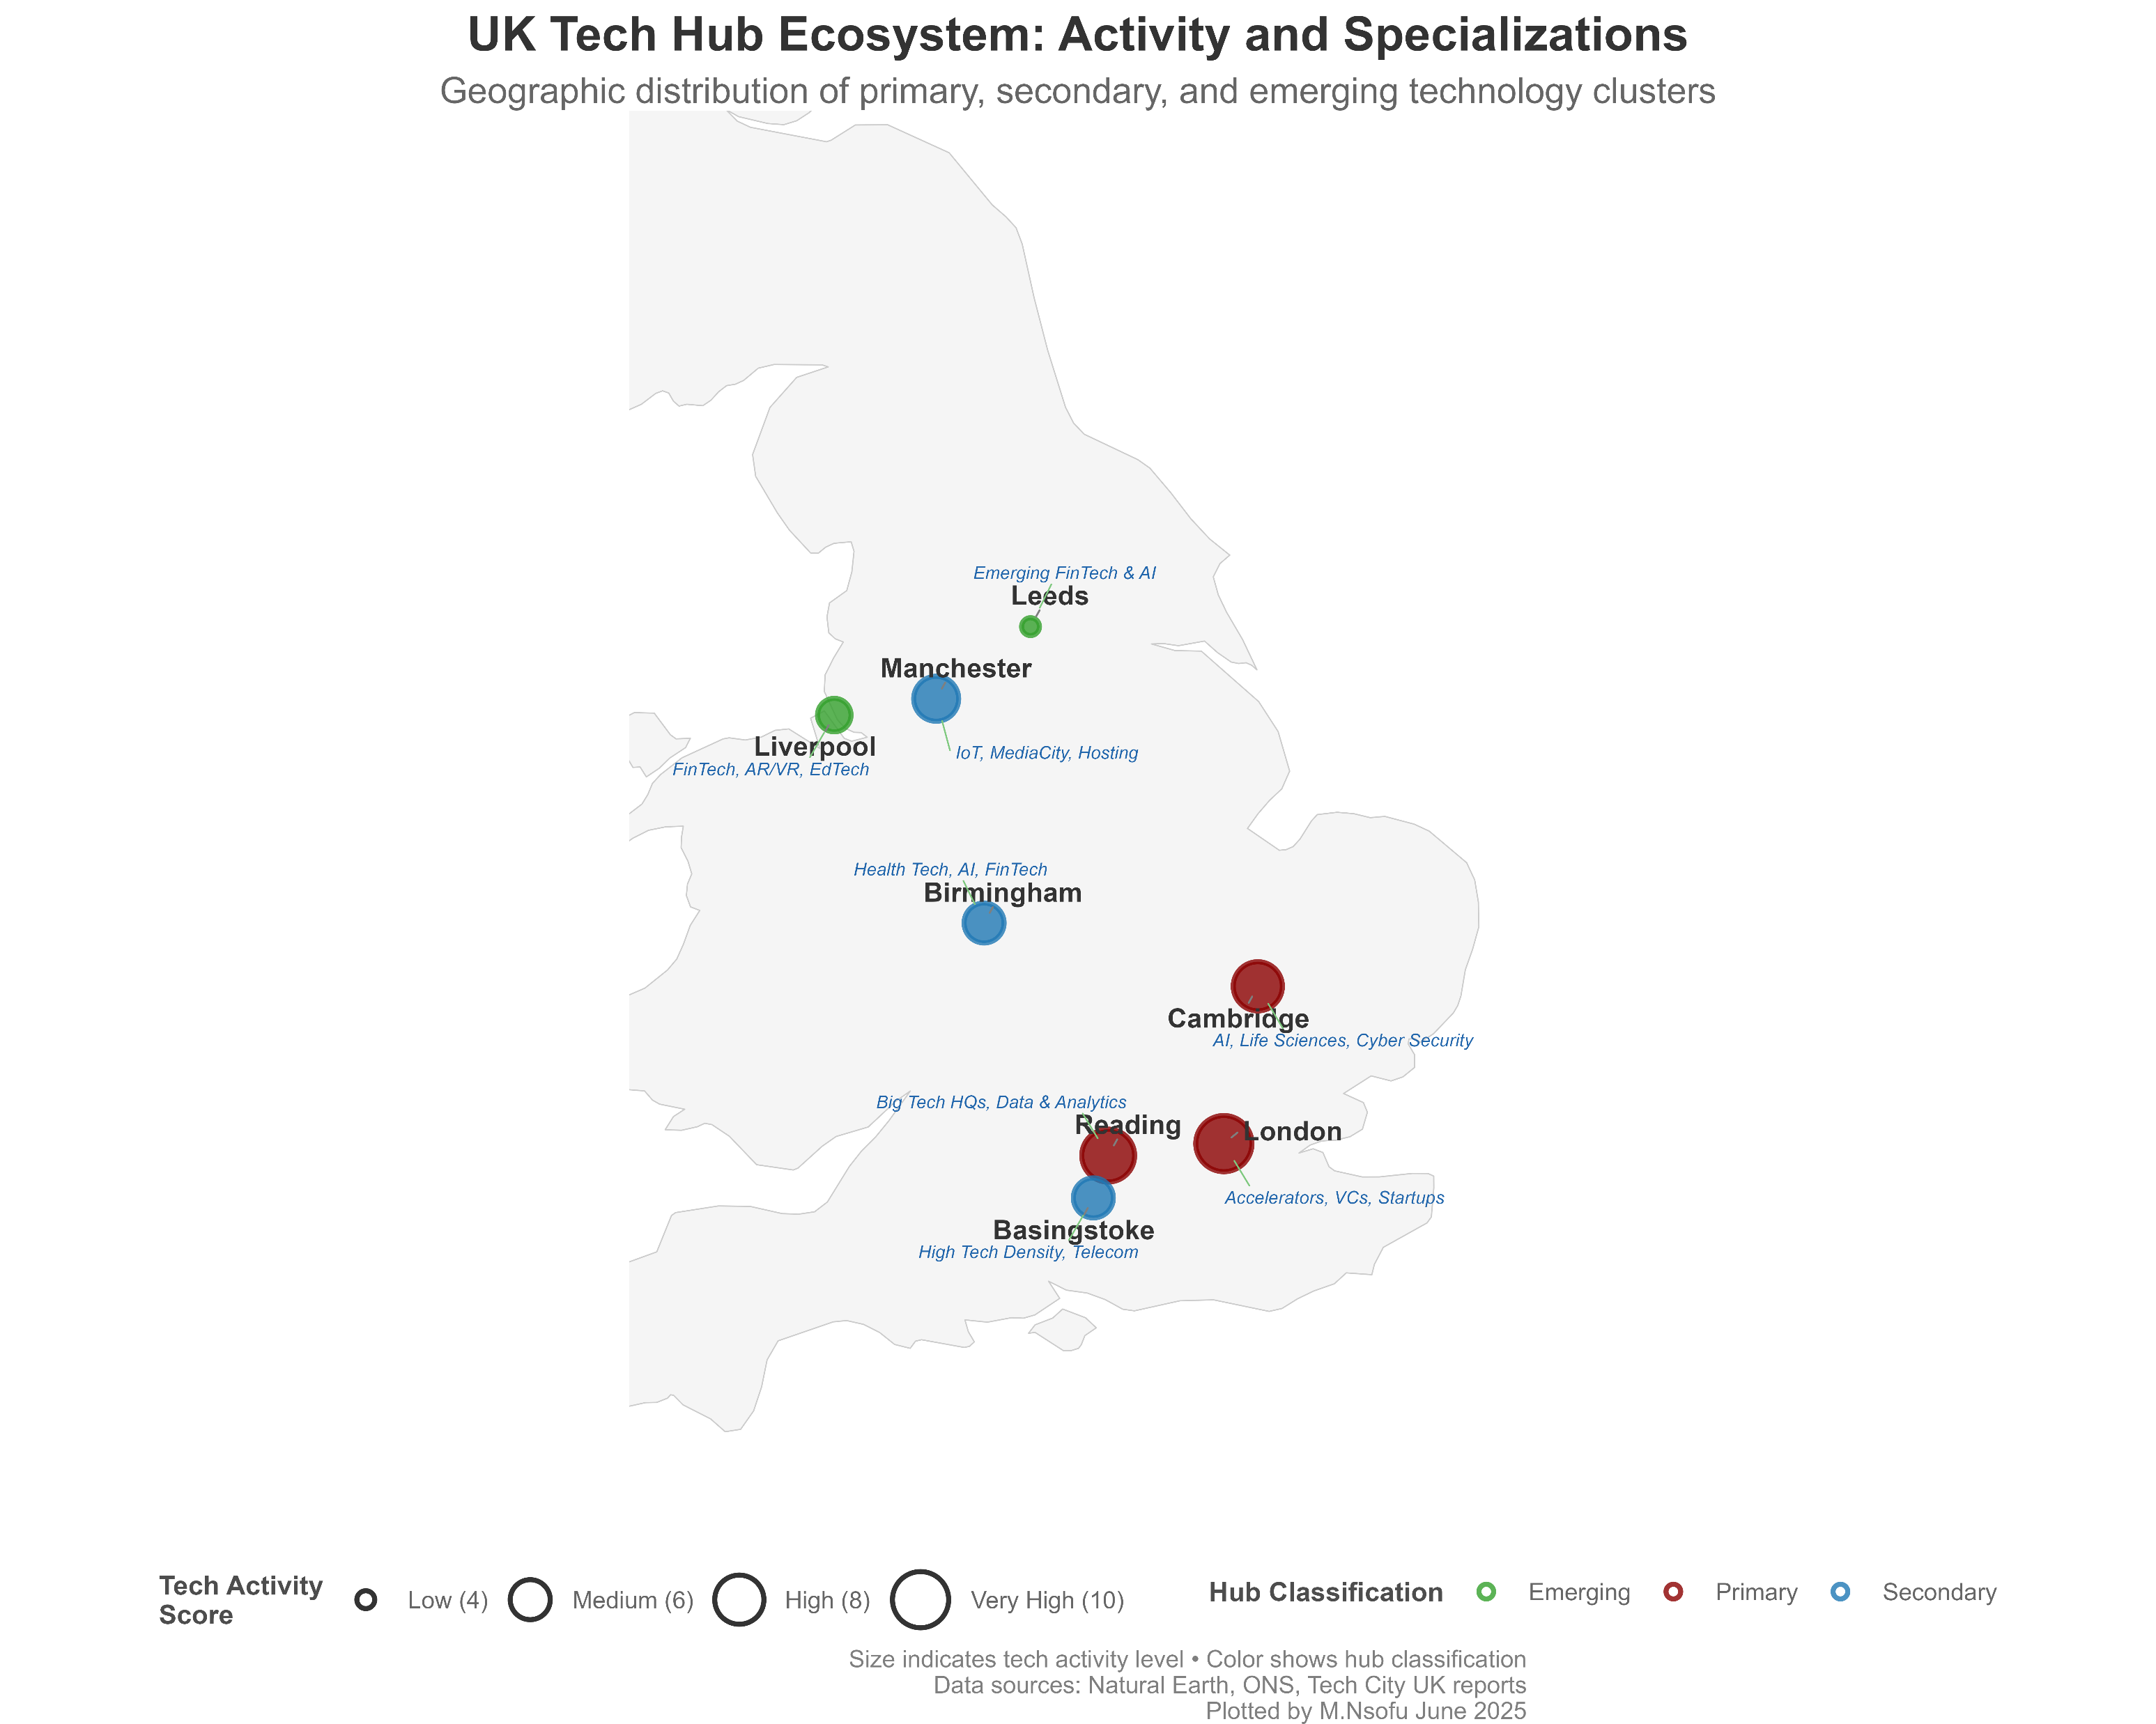
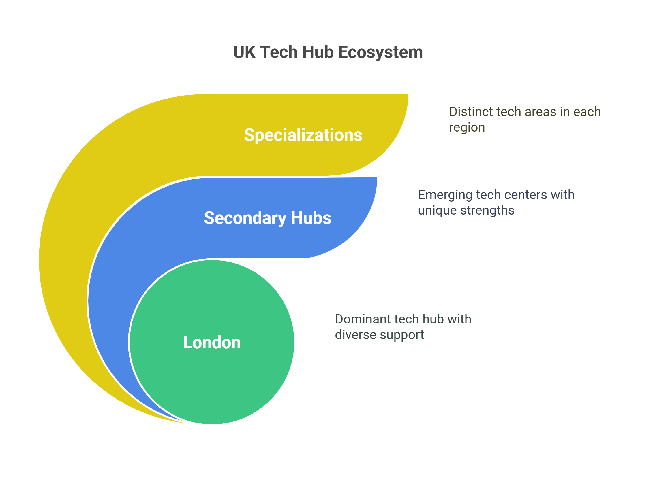
UK Tech Hub Ecosystem & Geographic Distribution

Slide 3
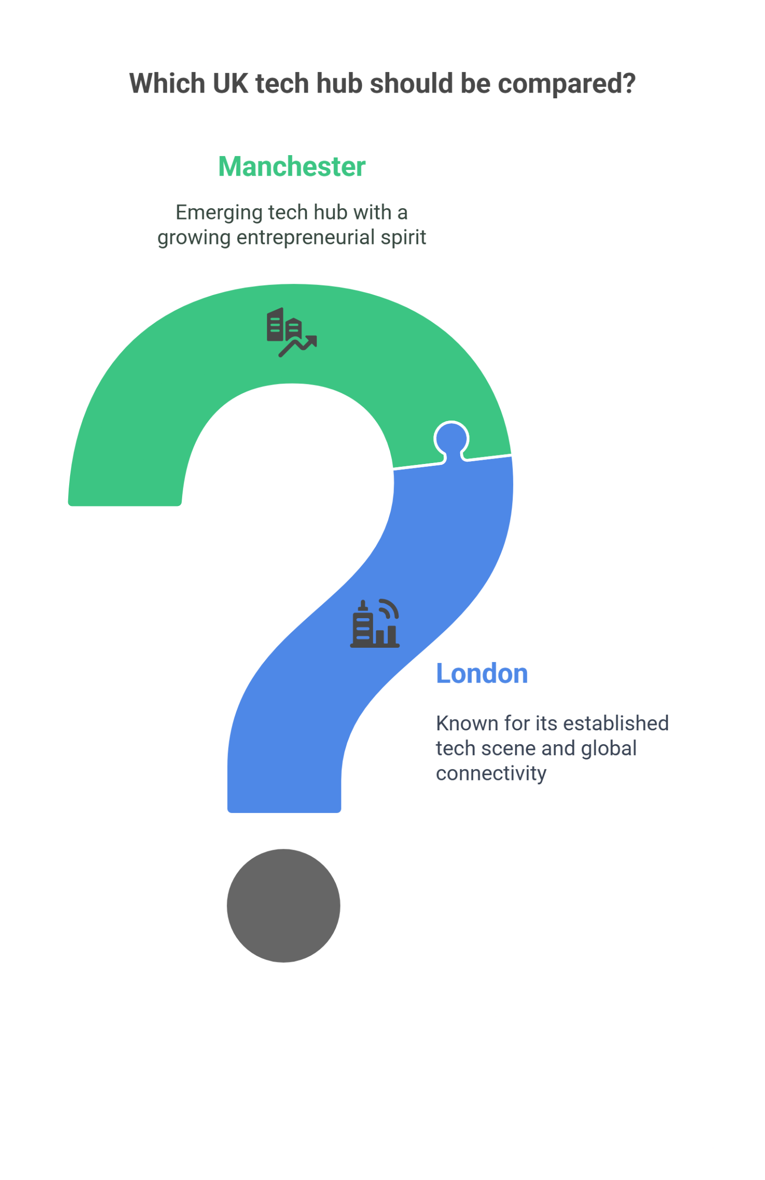
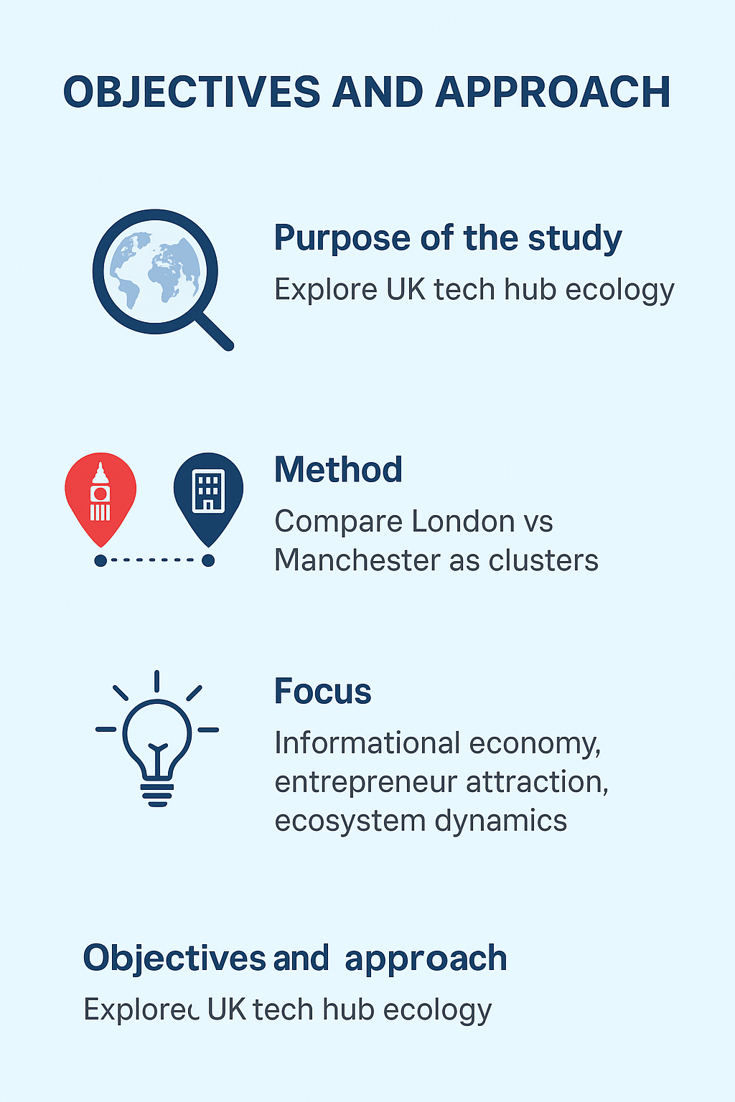
Objectives and Approach

Slide 4
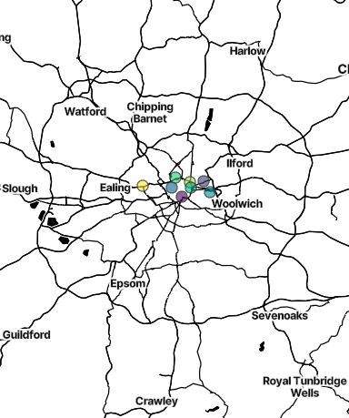
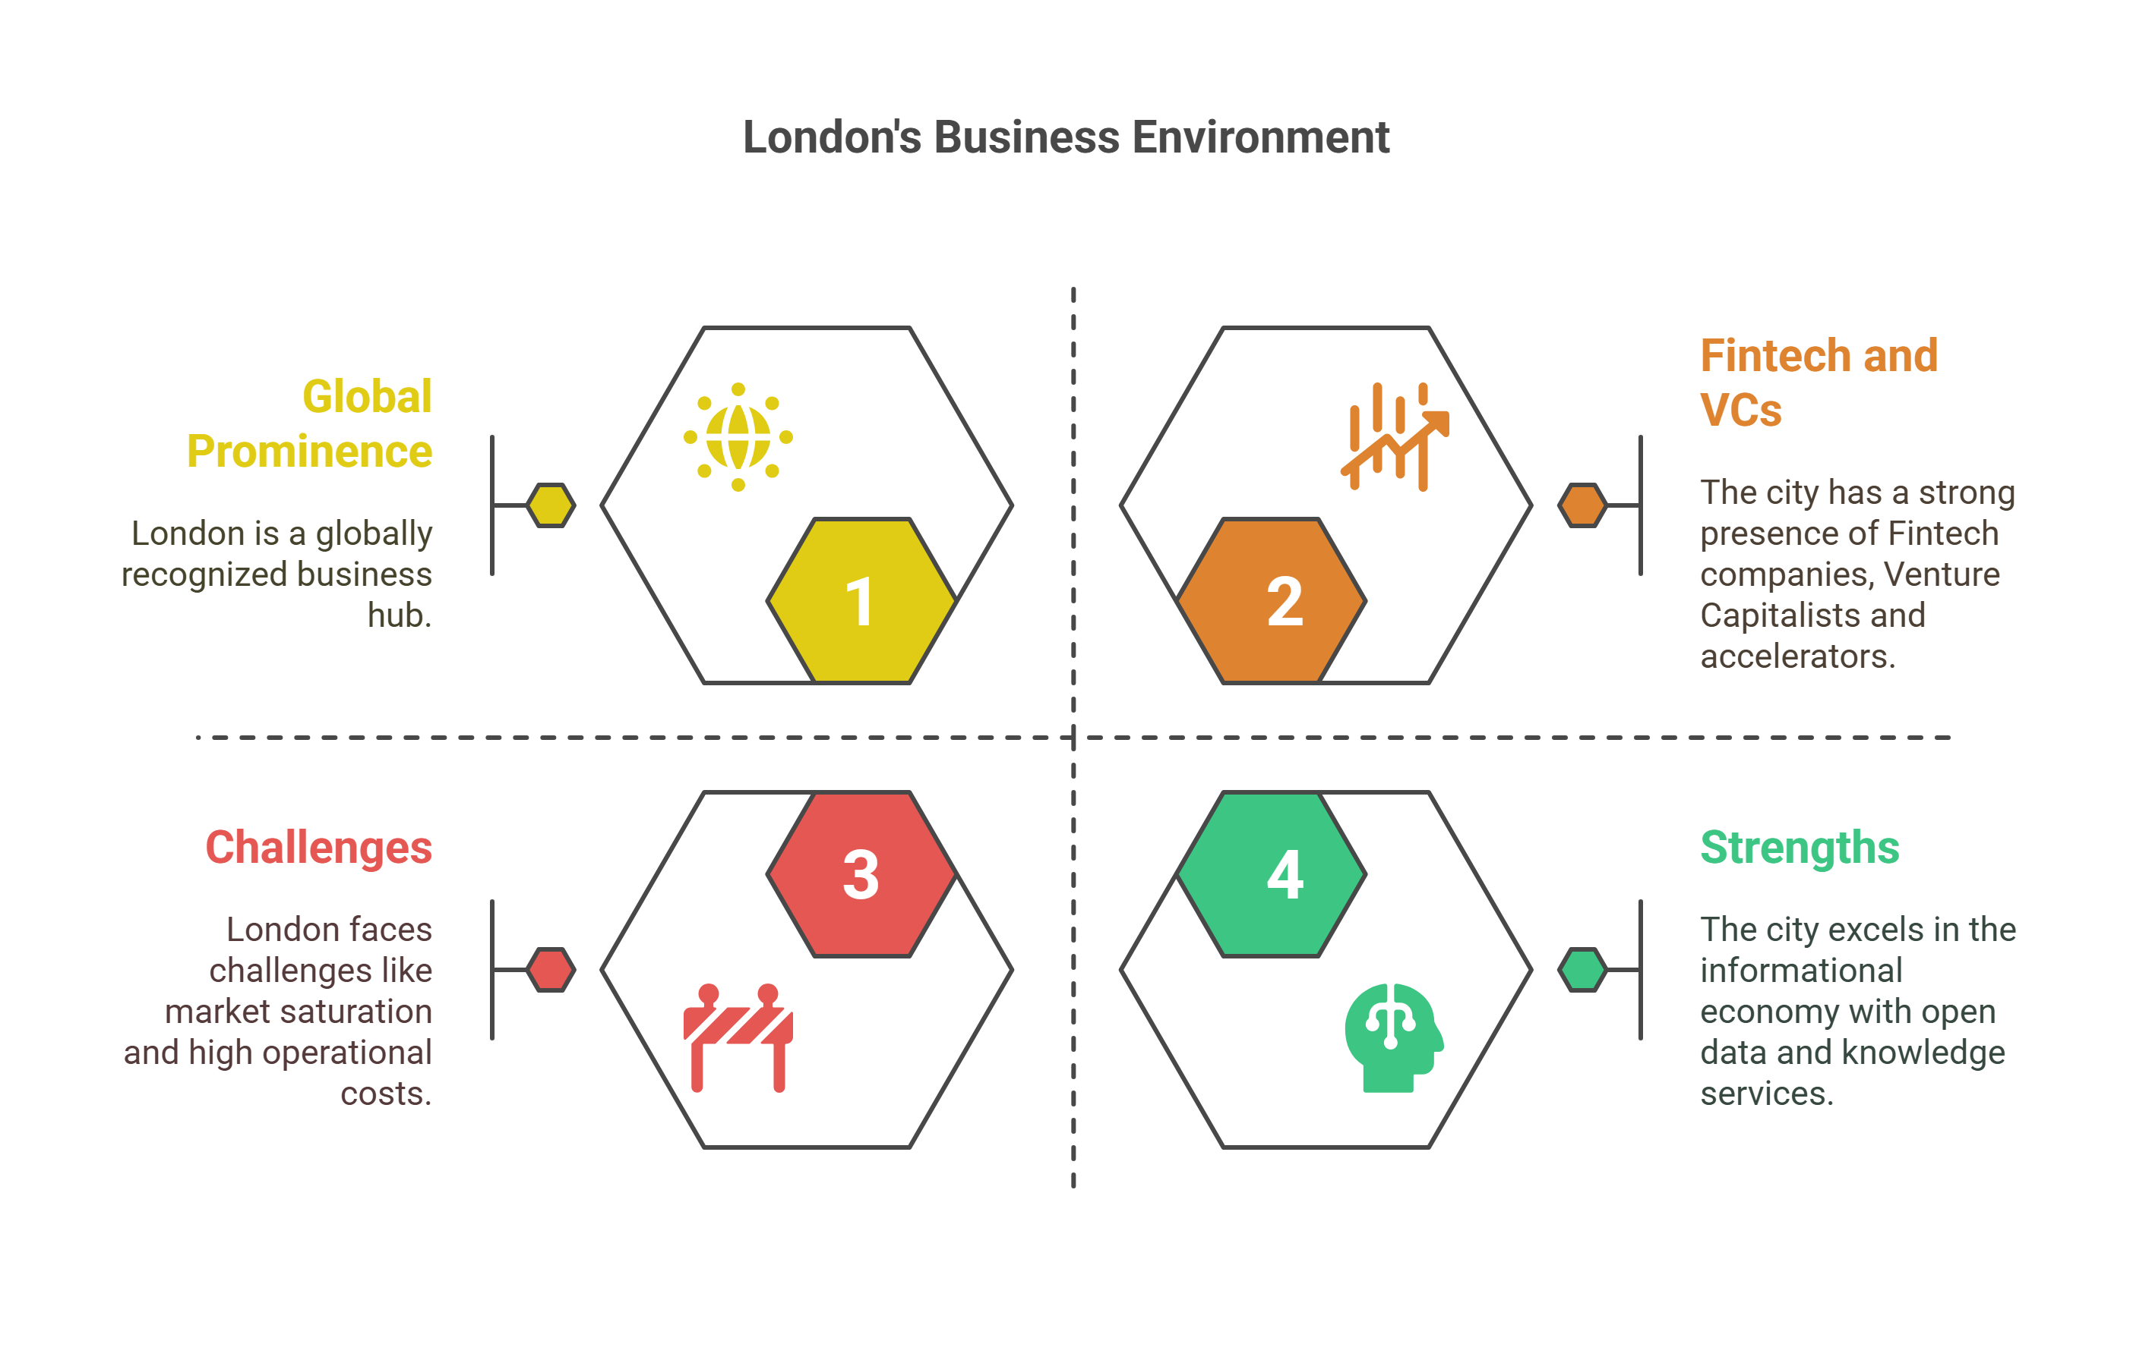
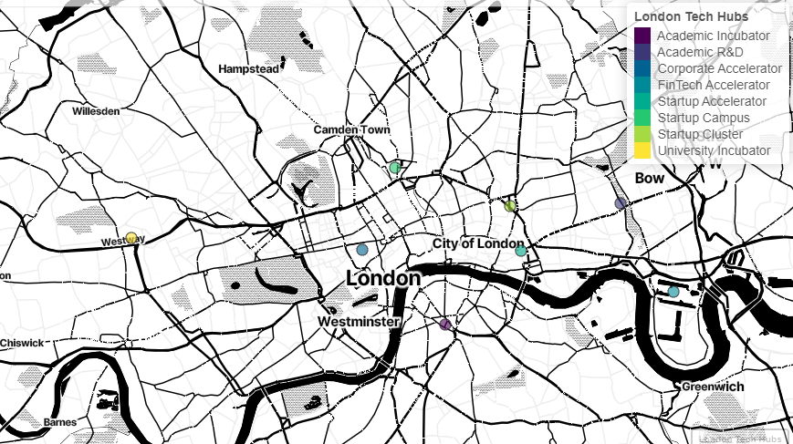
Cluster Deep Dive: London
Note: Maps on the right are created using R (Mapview package). Code is available on request.

Slide 5
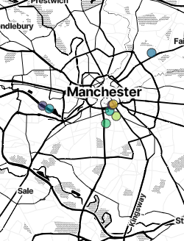
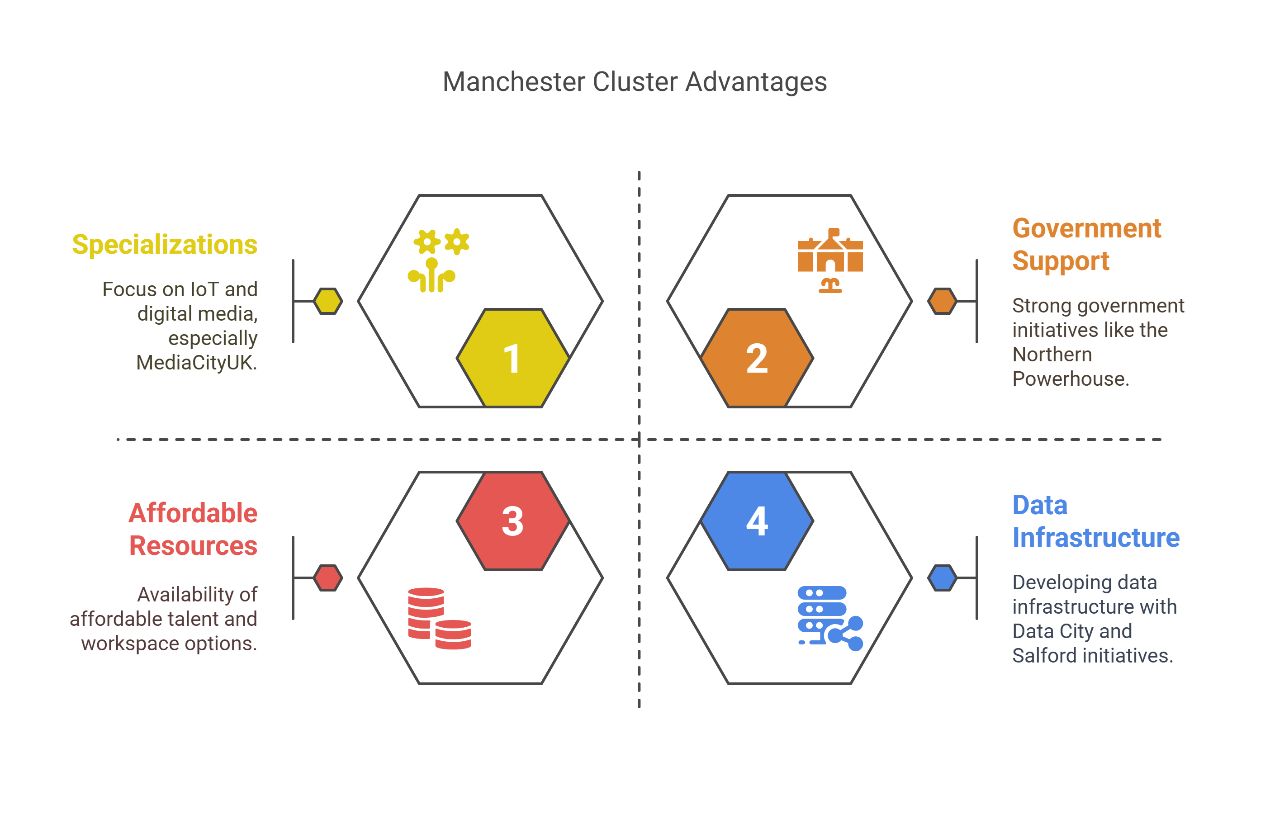
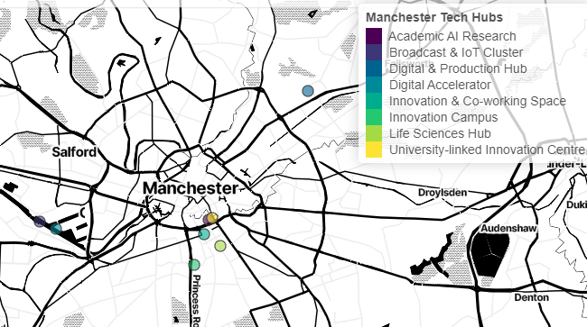
Cluster Deep Dive: Manchester
Note: Maps on the right are created using R (Mapview package). Code is available on request.

Slide 6
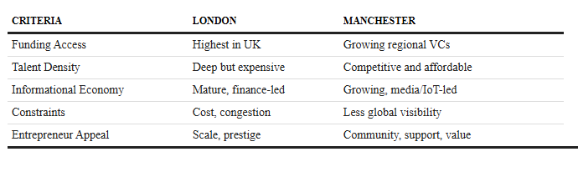
Comparison Between London and Manchester

Slide 7
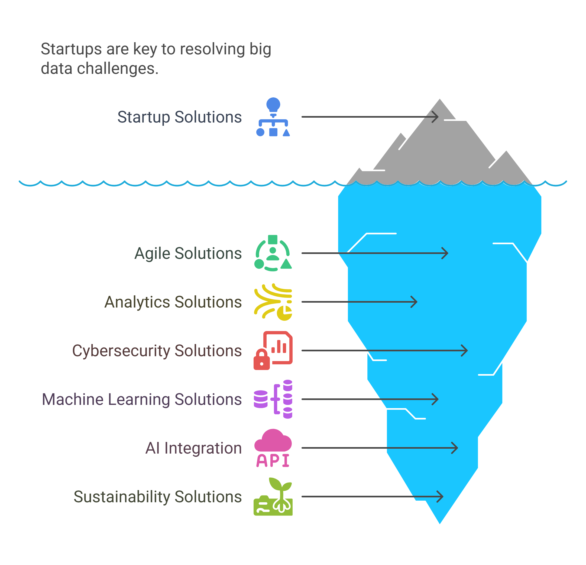
Role of Startups in Addressing Big Data Challenges
Startups are central to resolving big data issues, offering agile and scalable solutions in analytics, cybersecurity, and machine learning.
Cambridge-based firms like Darktrace exemplify the integration of AI into big data defence strategies.
Green startups (e.g., Fuergy, Power Ledger) also demonstrate how big data enables sustainability and Smart energy management.

Slide 8
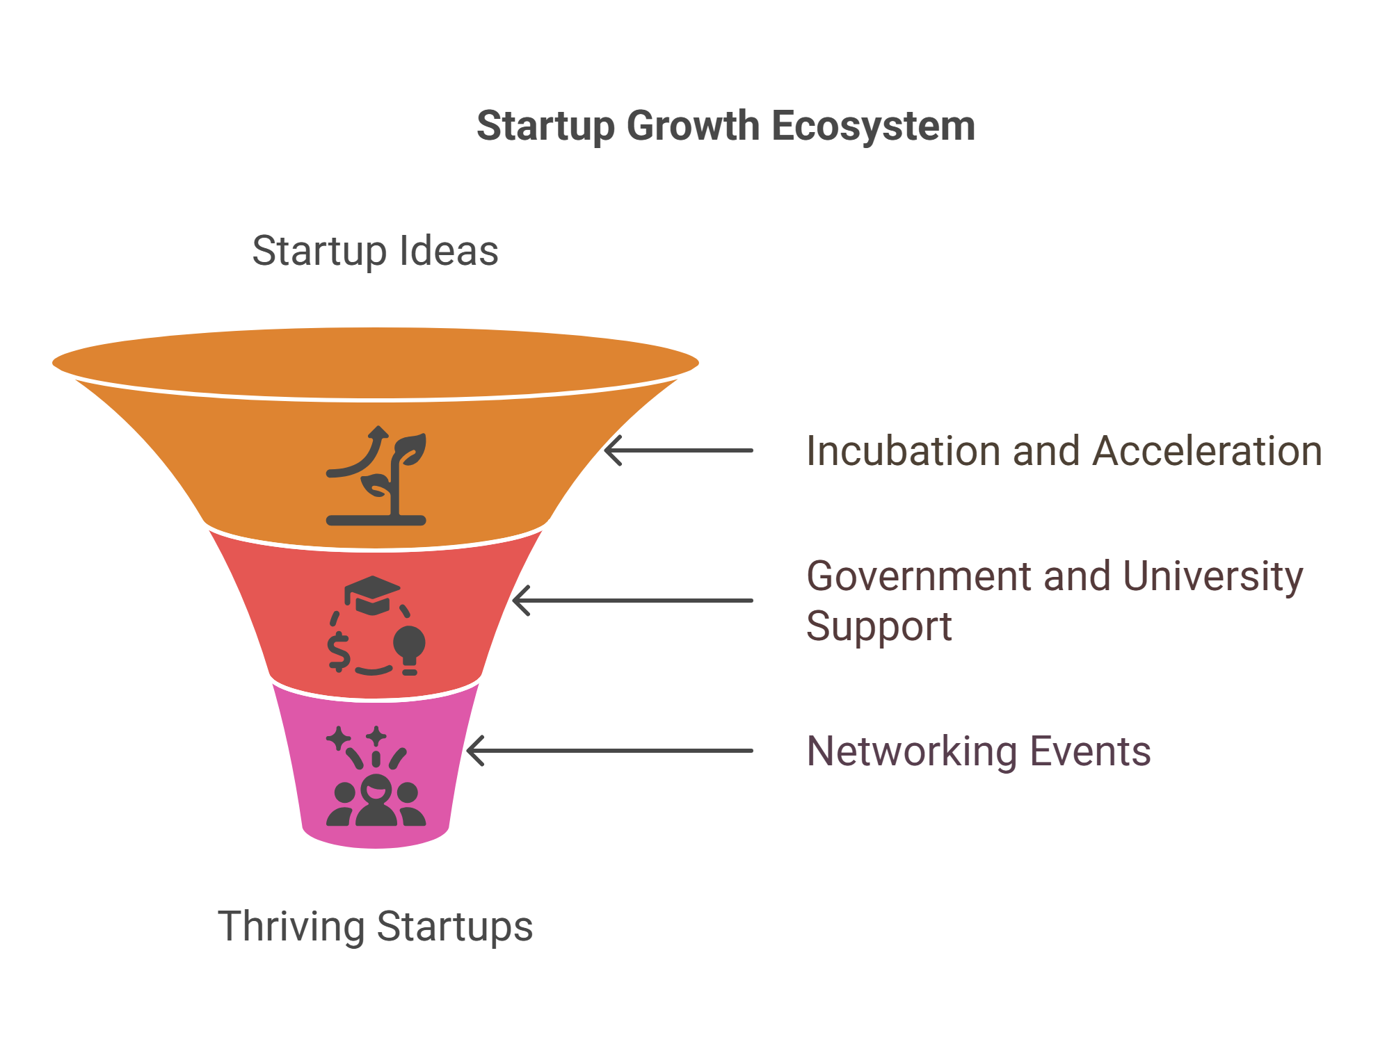
Infrastructure and Support Systems
Incubators and accelerators (e.g., Level 39, Wayra UK, Pi Labs) provide startups with mentorship, funding access, and collaborative space.
Government support and proximity to universities (e.g., Cambridge, Birmingham) help bridge academia and industry.
Events like London Tech Week and Big Data London foster knowledge exchange and networking.

Slide 9
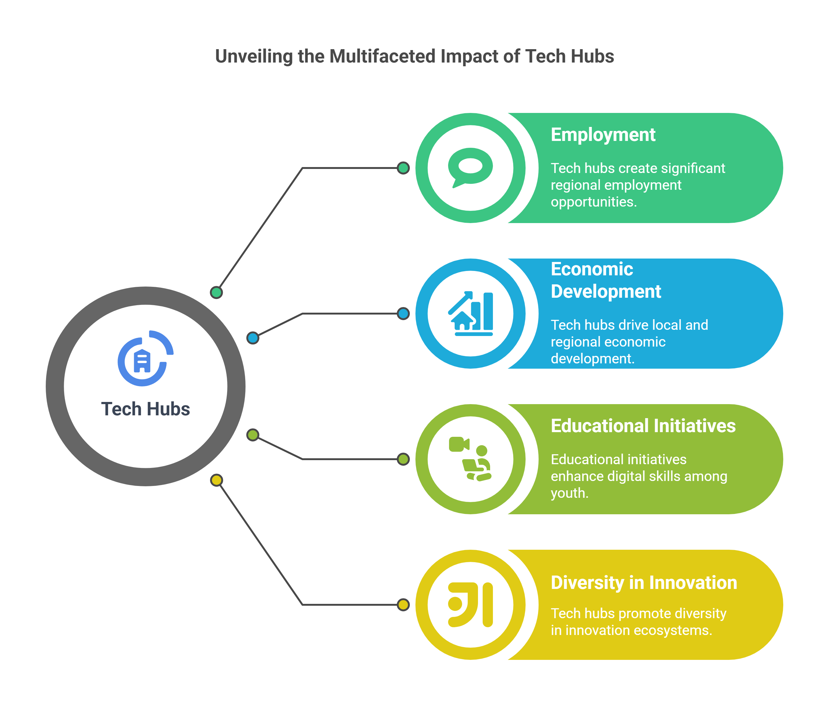
Socioeconomic and Human Impact
Tech hubs contribute to regional employment (e.g., over 62,000 digital jobs in Manchester) and drive local economic development.
Educational initiatives, such as Studio Liverpool, engage youth in digital skills development.
Ecosystem inclusivity promotes diversity in innovation, with cities like Liverpool emphasising edtech and social impact startups.

Slide 10
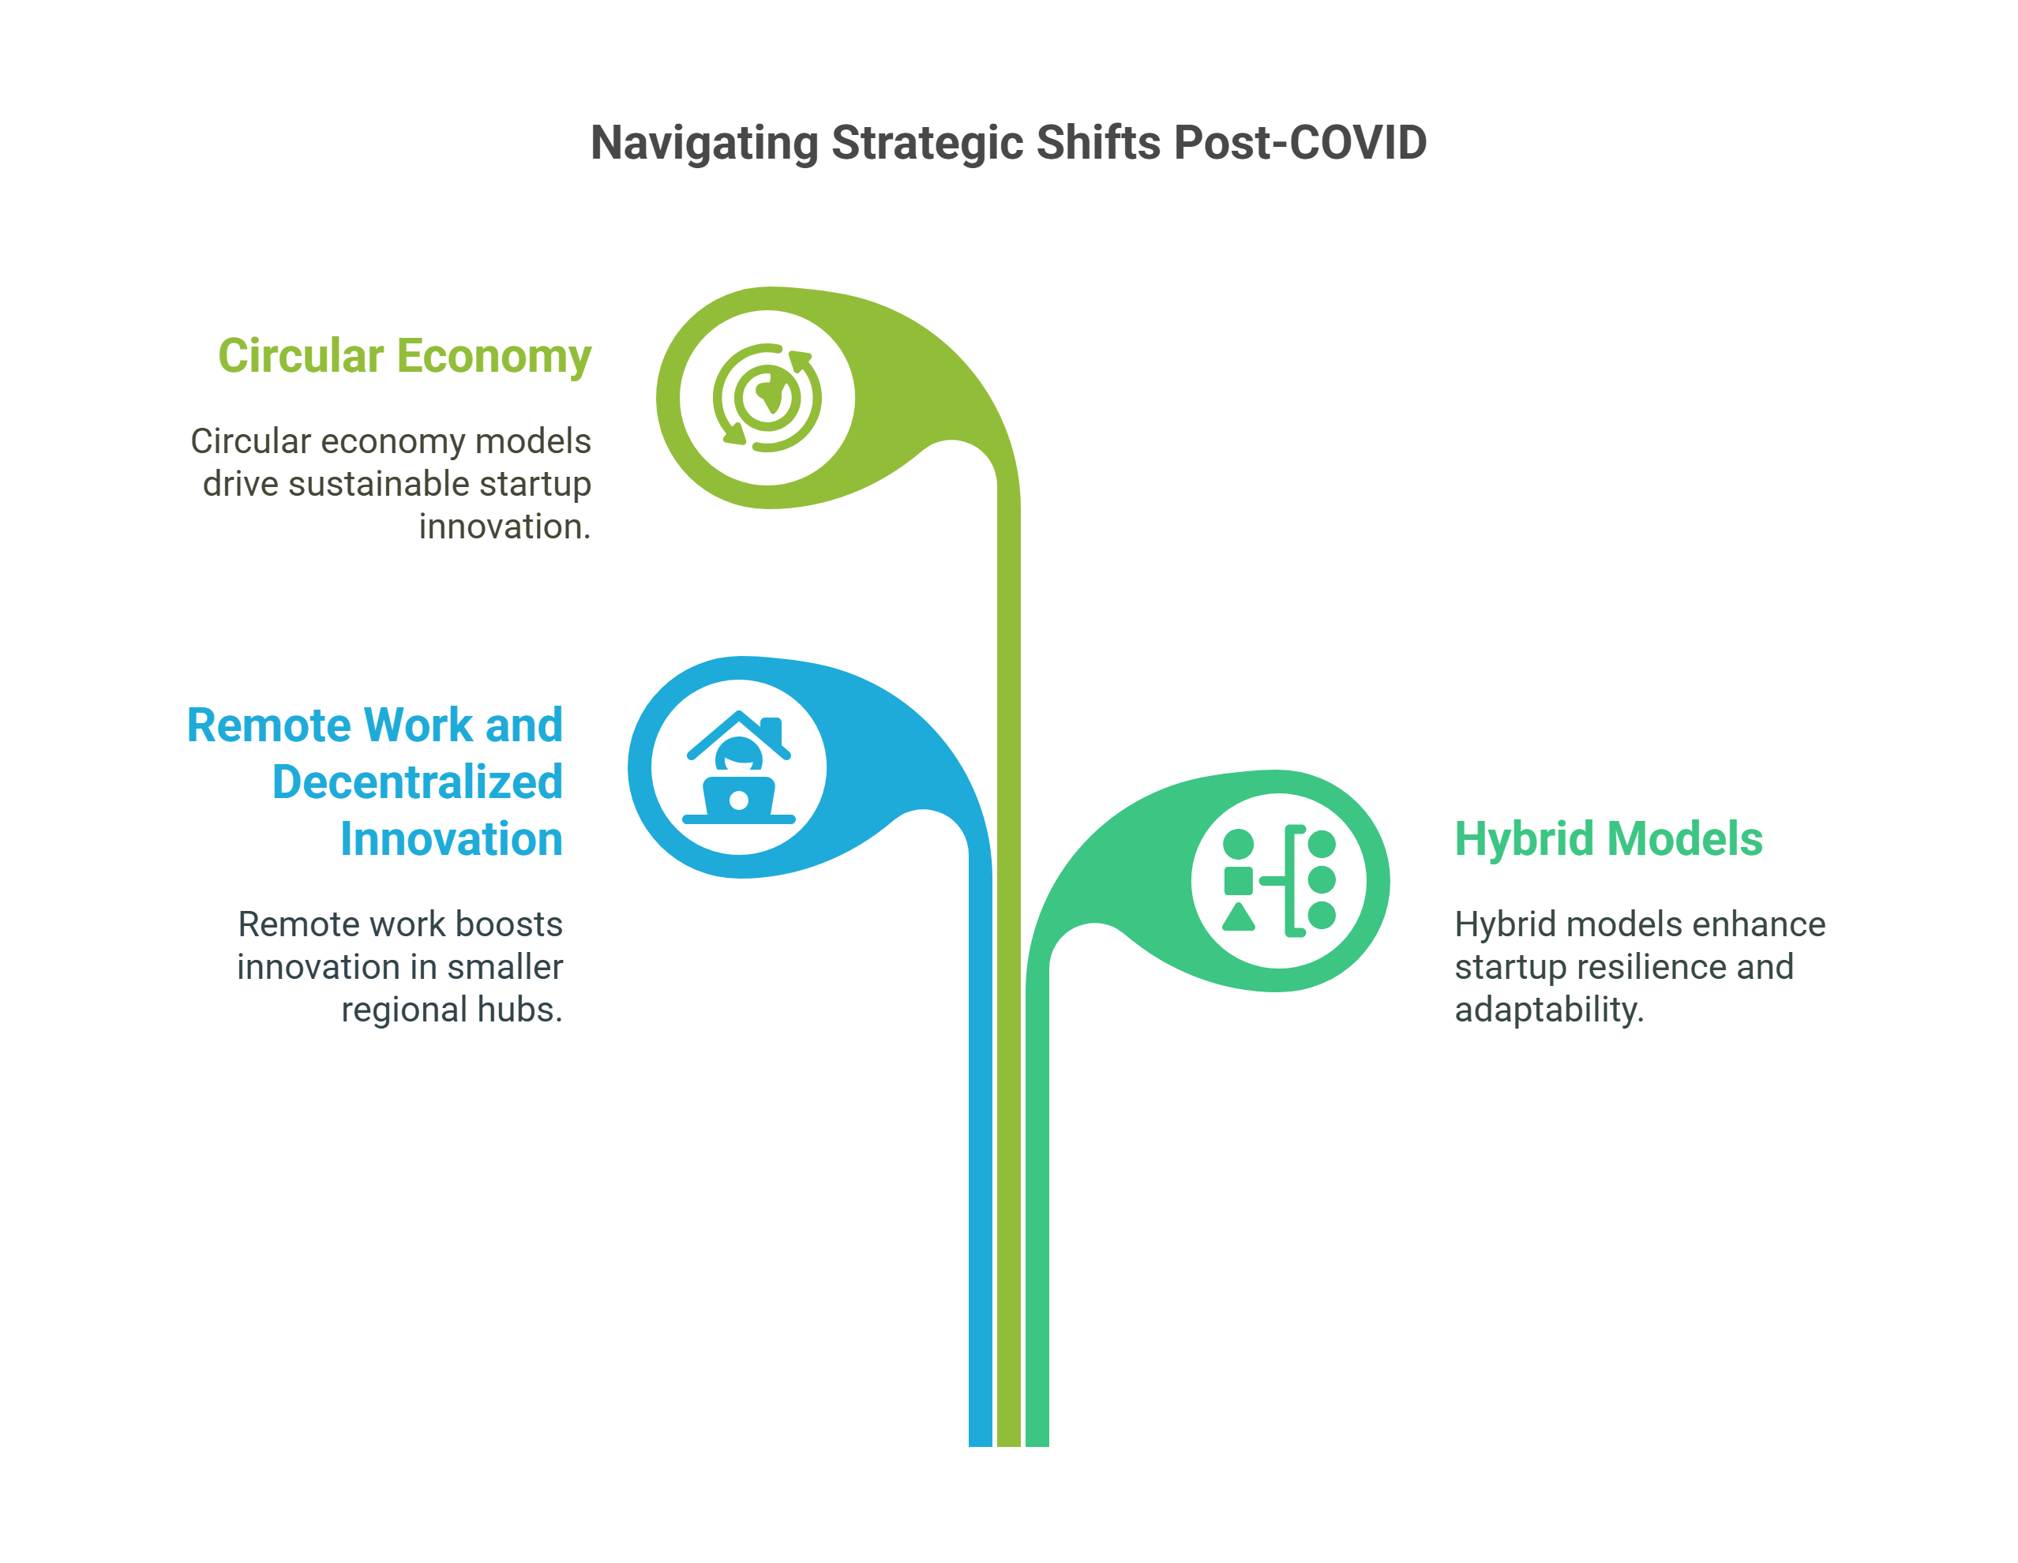
Strategic Implementation in a Post-COVID Context
COVID-19 has catalysed remote work and decentralised innovation, enhancing opportunities in smaller hubs (e.g., Newbury, Bristol).
Startups adapt via hybrid models, emphasising resilience, sustainability, and digital transformation.
The shift supports Circular Economy models, where circular startups innovate in design, waste reduction, platforms, and services.

Slide 11
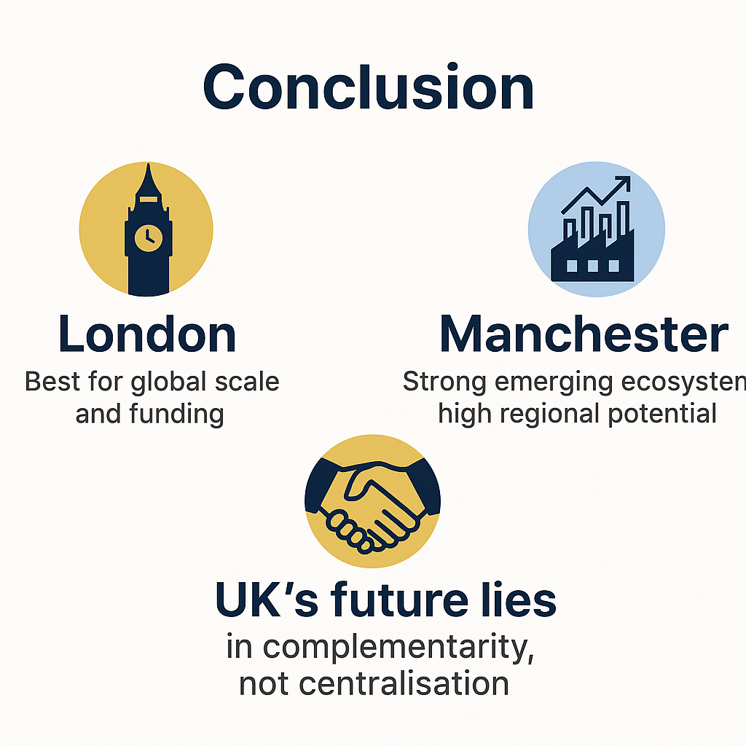
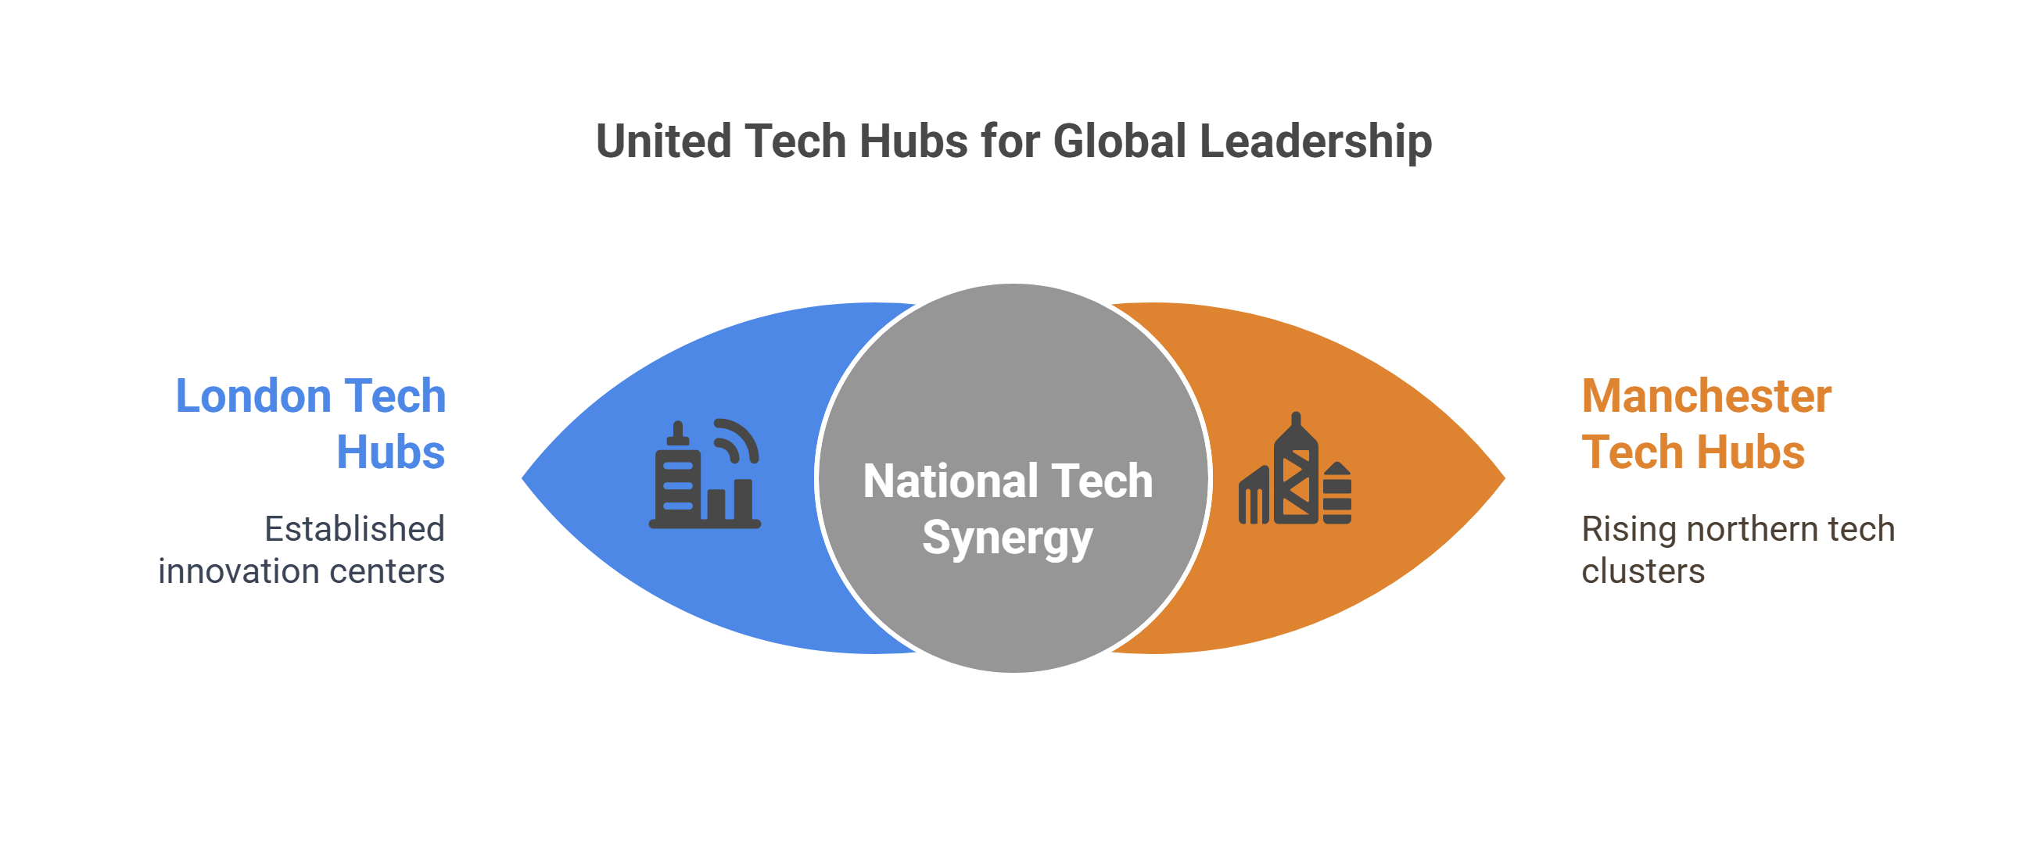
Conclusion
The government should build a sustainable future that leverages both London tech hubs and the emerging Manchester ones to ensure a future than is strong and globally competitive

Slide 12
References
Big Data London (2022) Event Highlights and Insights. Available at: https://bigdataldn.com (Accessed: 29 June 2025).
Centre for Cities, 2020. Core Cities Outlook. [online] Available at: https://www.centreforcities.org [Accessed 30 Jun. 2025].
Department for Digital, Culture, Media & Sport (DCMS), 2021. UK Digital Strategy. [online] Available at: https://www.gov.uk/government/publications/uk-digital-strategy [Accessed 30 Jun. 2025].
London Tech Week, 2023. Programme Overview. [online] Available at: https://londontechweek.com [Accessed 30 Jun. 2025].
Mazzucato, M., 2018. The Entrepreneurial State: Debunking Public vs Private Sector Myths. Penguin.
Nesta, 2020. The Geography of Innovation Clusters in the UK. [online] Available at: https://www.nesta.org.uk/report/ [Accessed 30 Jun. 2025].
Tech Nation, 2021. Tech Nation Report 2021. [online] Available at: https://technation.io/report2021/ [Accessed 30 Jun. 2025].

